Slide 1
Evaluation STEREO III programme

Slide 2
Outcome OF STEREO III PROGRAMME
Notes:
Achterom kijken naar wat gerealiseerd werd

Slide 3
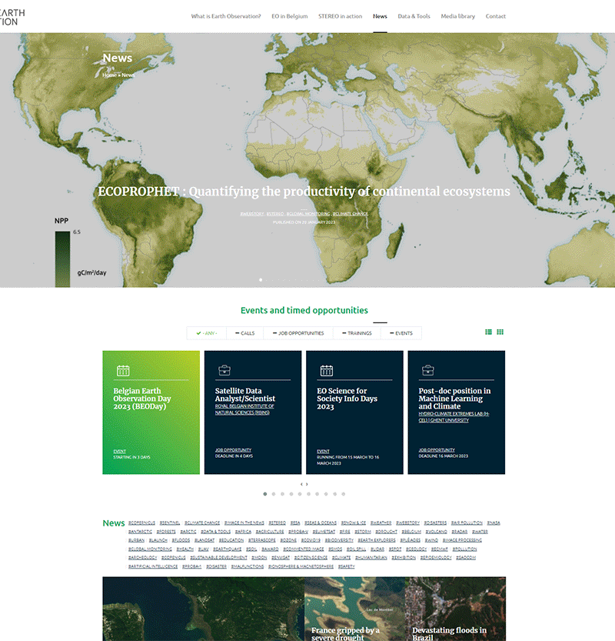
STEREO III accomplishments: valorisation and support
New website launched in October 2018
News items published last year: 251
Webstories published since October 2018: 57
Events and Opportunities published last year: 219
Events (co-)organized during STEREO III: 19 (including IGARSS 2021) + 9 sponsored
Satellite images acquired: 935 for 23 projects

Slide 4
STEREO III accomplishments: valorisation and support
Belgian Earth Observation Website: http://eo.belspo.be

Slide 5
STEREO III projects in figures
Promotors and organisations:
Peer reviewed papers: 450 and counting
Conference presentations/posters: 287/75
Open access software/data: 34/16
 | Belgium | Foreign
Promotors | 133 | 56
New to STEREO | 94 | 51
New to RS | 15
PhD students | 37
Research departments/labs | 58 | 44
Organisations | 27 | 43
Number of countries |  | 16

Slide 6
Projects and paper output
Project type | # of projects | # of papers
Projects resulting from call
Thematic projects | 15 | 247
Exploration projects | 28 | 151
Innovation | 18 | 101
Spin-off | 7 | 38
BELAIR | 2 | 7
PROBA-V | 1 | 5
Application projects | 3 industry/ 4 administrations | 6
Shared cost projects | 7 | 21
DISSUP projects | 38 | 16
Transversal support projects
 | 20 | 8
TOTAL | 115 | 450
+ 39 in preparation
/ submitted

Slide 7
Projects per programme theme
Notes:
4 topics die er uitspringen op gebied van wetenschappelijke output

Slide 8
International standing STEREO III scientists
List of world’s top scientists per discipline:
29 Belgian SRIII promotors are represented (22%) (https://research.com/)
ENVIRONMENTAL SCIENCES | ECOLOGY AND EVOLUTION | EARTH SCIENCE
17 | 6 | 3
ENGINEERING AND TECHNOLOGY | COMPUTER SCIENCE | PLANT SCIENCE AND AGRONOMY
1 | 1 | 1
List of highly-cited scientists (https://clarivate.com)
2022 list of top rising stars in science
(oldest publication is from 12 or less years ago –
https://research.com/scientists-rankings/rising-stars)
1 STEREO promotor
2021 | 2022
5 | 5

Slide 9
STEREO III EVALUATION

Slide 10
SRIII programme evaluation
Contract carried out by consortium DIALOGIC / EFI
Executed second semester of 2021 (several projcts still ongoing at the time)
Evaluation steps:
Portfolio analysis
Bibliometrics (scientific impact)
Survey
Interviews
Workshop on impact pathways
Expert panel to validate results evaluation – 8 international experts
Notes:
We hebben eindrapport nog niet maar beoordeling en aanbevelingen van panel experten kunnen we delen

Slide 11
RECOMMENDATIONS FROM STEREO III EVALUATION

Slide 12
Appraisal by Expert Panel
Programme management
Well-structured – well managed
Minor administrative burden
Diversity of calls
Evaluation process
Steering Committees
Community building
BEODAYS
Networks
International partners
Research
Open science approach
Strong impact
Complementing operational projects
Catalyst for external projects
Career booster
Notes:
Veel positieve dingen te zeggen beheer / structuur – wetenschappelijke uitput etc.

Slide 13
Recommendations
Focus on high quality research
Keep variety of project types
Keep international character of projects
Foster new talent
Connect fundamental research with societal needs
Connect projects and groups
Connect research and policy makers and industry
Connect STEREO with ESA and EU
Share datasets and tools
EO = satellite + airborne + in-situ
Notes:
Veel positieve dingen te zeggen beheer / structuur – wetenschappelijke uitput etc.

